Slide 1
Deep Learning
Hyperparameter tuning &
How to set up structured experiments
Chapter 13.1
Vera Hollink
2025

Slide 2
Contents
Thinking about evaluation
Splitting data
Finding the best model
Hyperparameter tuning with Keras
Reporting about experiments

Slide 3
Contents
Thinking about evaluation
Splitting data
Finding the best model
Hyperparameter tuning with Keras
Reporting about experiments

Slide 4

Thinking about evaluation
Metric
How to measure success
Accuracy, MSE, …
What do you want to know
What is the best model?
How good is the best model?

Slide 5
Contents
Thinking about evaluation
Splitting data
Finding the best model
Hyperparameter tuning with Keras
Reporting about experiments

Slide 6

Splitting data
Same data for training and testing
Bad idea
Model is optimized for training data → overly optimistic view on performance
Overfitting not detected
Split data
Part for training: training set
Part for evaluation: test set

Slide 7
Splitting data holdout / percentage split
Complete data set
x | x | x | x | x | x | x | x | x | x
Randomly select x% as test data
train | test | train | train | train | test | train | train | test | train
Risk?
Atypical test set

Slide 8
Splitting data k-fold cross-validation
Complete data set
x | x | x | x | x | x | x | x | x | x
Fold 1:
test | test | train | train | train | train | train | train | train | train
Fold 2:
train | train | test | test | train | train | train | train | train | train
Fold 3:
train | train | train | train | test | test | train | train | train | train
Fold 4:
train | train | train | train | train | train | test | test | train | train
Fold 5:
train | train | train | train | train | train | train | train | test | test
Average results over folds

Slide 9
Splitting data: 3 parts
Split data:
Training set
Validation set
Test set
What is the best model? Try various models/hyperparameter values:
training: training set
evaluation: validation set
How good is the best model?
training: complete training set (=training + validation)
evaluation: test set
training set
validation set
test set
training set
test set

Slide 10
Training set – validation set – test set
train model on training set
change model
evaluate model on validation set
train final model on the complete training set
evaluate final model on the test set

Slide 11
Training and validation set: k-fold cross-validation
Complete training+validation set (set apart from the test set)
x | x | x | x | x | x | x | x | x | x
Fold 1:
val | val | train | train | train | train | train | train | train | train
Fold 2:
train | train | val | val | train | train | train | train | train | train
Fold 3:
train | train | train | train | val | val | train | train | train | train
Fold 4:
train | train | train | train | train | train | val | val | train | train
Fold 5:
train | train | train | train | train | train | train | train | val | val
Average results over folds

Slide 12
Training and test set: k-fold cross-validation
Complete data set set (train = train+validation)
x | x | x | x | x | x | x | x | x | x
Fold 1:
test | test | train | train | train | train | train | train | train | train
Fold 2:
train | train | test | test | train | train | train | train | train | train
Fold 3:
train | train | train | train | test | test | train | train | train | train
Fold 4:
train | train | train | train | train | train | test | test | train | train
Fold 5:
train | train | train | train | train | train | train | train | test | test
Average results over folds

Slide 13
Contents
Thinking about evaluation
Splitting data
Finding the best model
Hyperparameter tuning with Keras
Reporting about experiments

Slide 14
Finding the best model
Type of model (CNN, Transformer, …)
Hyperparameter values
Difference between parameters and hyperparameters?
Parameters
weights of the nodes
optimized during training
Hyperparameters
model settings (e.g. number of nodes in a layer)
set by the user before training

Slide 15
Examples of hyperparameters?
Number of nodes per layer
Activation function of each layer
Optimizer (Adam, RMSprop, …)
Batch size
Learning rate
Number of training epochs
CNN
Filter size
Stride
Padding
….

Slide 16
Hyperparameter tuning
Determine which model types to try
For each model: find best performing combination of hyperparameter values:
List hyperparameters to tune
For each hyperparameter:
List values to try
For each combination of values:
Train model on training set
Evaluate model on validation set
Select model with best performing combination
Define the search space

Slide 17
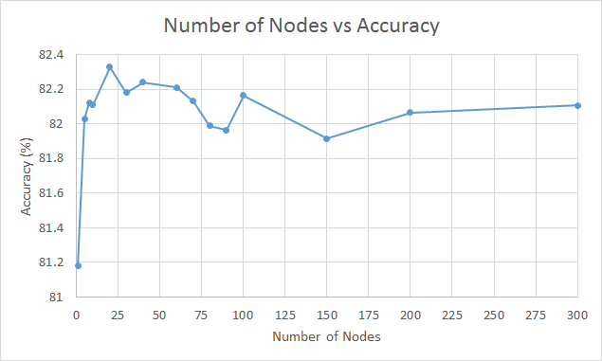
Tuning one hyperparameter
List values to try
Use value that gives best performance

Slide 18
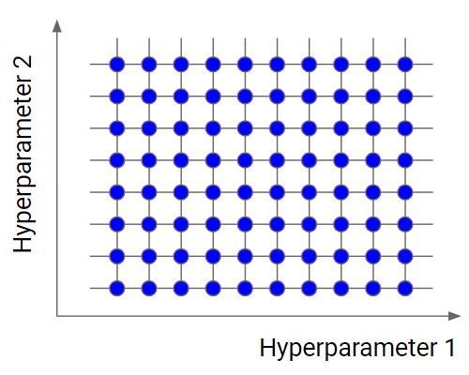
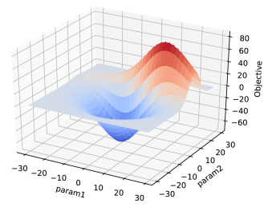
Tuning two hyperparameters
Try all combinations
Number of nodes = 5,10,15,…
Learning rate = 0.001, 0.005, 0.01, …

Slide 19
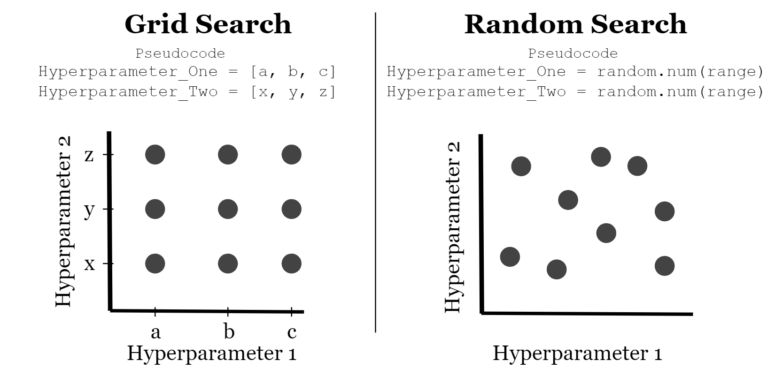
Combinations of values 1: grid search
Exhaustively try all combinations
n hyperparameters with m values:
m^{n} combinations

Slide 20
Combinations of values 2: random search
Try random combinations
Run until time is up or fixed number of combinations

Slide 21
Combinations of values 3: Hyperband
Exhaustively try all combinations for a small number of epochs
Repeat
Eliminate bad performing combinations
Train remaining combinations further

Slide 22
Combinations of values 4: Bayesian optimization
Try some combinations
Repeat
Estimate performance of other combinations
Try promising and informative combinations

Slide 23
Splitting data
training set
validation set
test set
Why not use the test set during model selection and hyperparameter tuning?
Hyperparameters optimized for our validation set → overly optimistic view on performance on unseen data
Test set gives unbiased evaluation
→ Don’t change the model after testing on the test set

Slide 24
Contents
Thinking about evaluation
Splitting data
Finding the best model
Hyperparameter tuning with Keras
Reporting about experiments

Slide 25

KerasTuner
import keras_tuner
Specify search space
Select value range for each hyperparameter
Function to build models from search space
Choose tuner
Grid search, random search, etc.
Run tuner
Finds best combination of hyperparameter values

Slide 26
KerasTuner: 1. Specify search space
container for the hyperparameter space
hp = keras_tuner.HyperParameters()
Boolean
hp.Boolean(“dropout”)
Integer range
hp.Int("units", min_value=8, max_value=32,step=8)
List of values
hp.Choice("activation", ["relu", "tanh"])
Float range
hp.Float("learning_rate", min_value=0.0001, max_value=0.01, sampling="log")
which values in range are tried: linear or log
Notes:
dot product gives relevance of word to otherword (highest for word itself)
Some normalization is left out for simplicity

Slide 27
KerasTuner: 2. Build models
def build_model(hp):
model = models.Sequential()
model.add(layers.Dense(units=hp.Int("units",min_value =8, max_value=32,step=8), activation="relu"))
model.add(layers.Dense(8, activation="relu"))
model.add(layers.Dense(10, activation="softmax"))
learning_rate = hp.Float("learning_rate", min_value=0.0001, max_value=0.01, sampling="log")
model.compile(optimizer=keras.optimizers.Adam( learning_rate=learning_rate), loss="categorical_crossentropy", metrics=["accuracy"])
return model
Notes:
dot product gives relevance of word to otherword (highest for word itself)
Some normalization is left out for simplicity

Slide 28
KerasTuner: 3. Choose tuner
model building function (previous slide)
tuner = keras_tuner.GridSearch(
hypermodel=build_model,
objective="val_accuracy",
max_trials=25,
executions_per_trial=1,
overwrite=True,
directory="C:/…/tuner output",
project_name="tuner_example",
)
Available tuners
keras_tuner.GridSearch
keras_tuner.RandomSearch
keras_tuner.BayesianOptimization
keras_tuner.Hyperband
max number of combinations to try If left out, all are tried)
run each combination x times
Notes:
dot product gives relevance of word to otherword (highest for word itself)
Some normalization is left out for simplicity

Slide 29
KerasTuner: 4. Run tuner
tuner.search(train_x, train_y, epochs=50, validation_data=(val_x, val_y))
best_hp = tuner.get_best_hyperparameters()[0]
tuned_model = tuner.hypermodel.build(best_hp)
➔ Demo script Tuner.py
Notes:
dot product gives relevance of word to otherword (highest for word itself)
Some normalization is left out for simplicity

Slide 30
Contents
Thinking about evaluation
Splitting data
Finding the best model
Hyperparameter tuning with Keras
Reporting about experiments

Slide 31

Reporting on experiments
Bad structure: process
We tried …
Results are …
Then we tried ..
Results were …
Therefore, we move to …
…

Slide 32
Reporting on experiments
Good structure: research
Selected models based on literature and task
For each model selected hyperparameter values to try based on literature.
Experimental setup
data split
evaluation measure based on task
Results
Tables
Graphs
Discuss in text

Slide 33
Reporting on experiments
Result table(s)
only include relevant information (not all output)
format your own tables (no screen shots)
data to be compared together in one table
e.g. results from various models

Slide 34

And now…
Define experimental setup for your own experiments
Search space
Models
Hyperparameters
Values
Tuner

